Slide 1
Welsh Learning Platform
Graphic user interface
Author: | fec11
Date: | 30/04/2020
Version: | 4.3
Status: | Release
Config ref: | SE_G17_UI_PRES

Slide 2
Ideal users
Ffion is Welsh student who is proficient in Welsh, but not completely
She still needs to look up in the dictionary sometimes
DICTIONARY
Jennifer works in a Welsh company and is taking Welsh courses
She already knows some of the language, but she wants to practice more
PRACTICING PLATFORM
John is an English student who wishes to learn Welsh
He is not studying the language professionally
He is using this platform in order to memorize all the Welsh words.
LEARNING PLATFORM

Slide 3
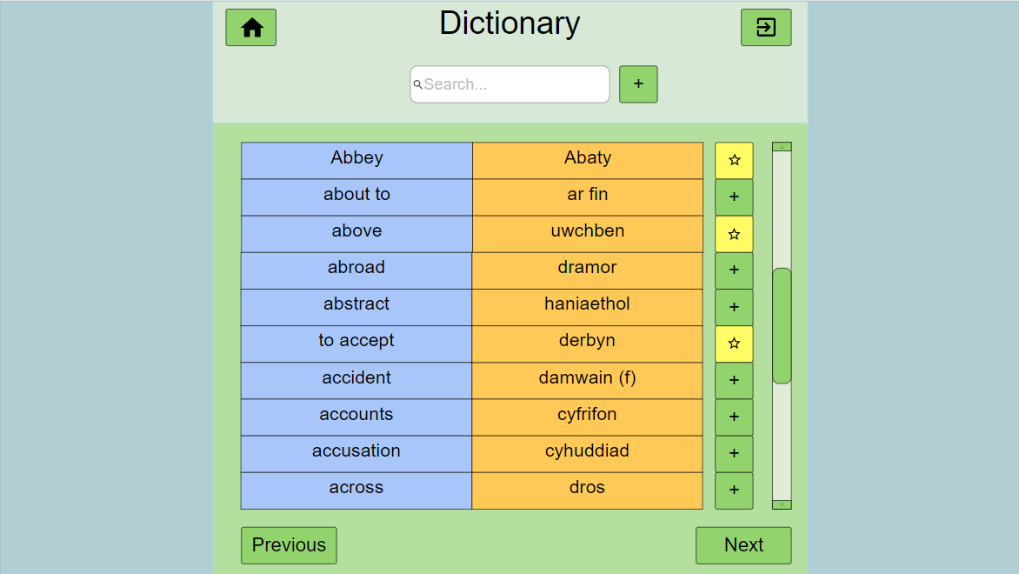
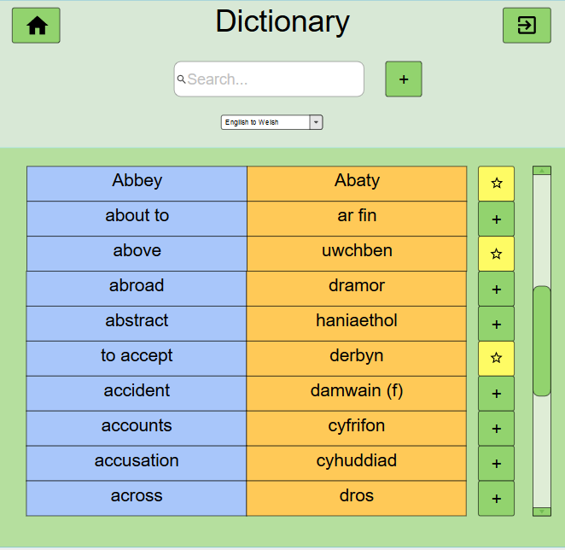
Welsh-English Dictionary
My words
Welsh-English Dictionary
Add new word
In dictionary if
Doesn’t exist yet
Search for words
Insert word
In “words to learn”

Slide 4
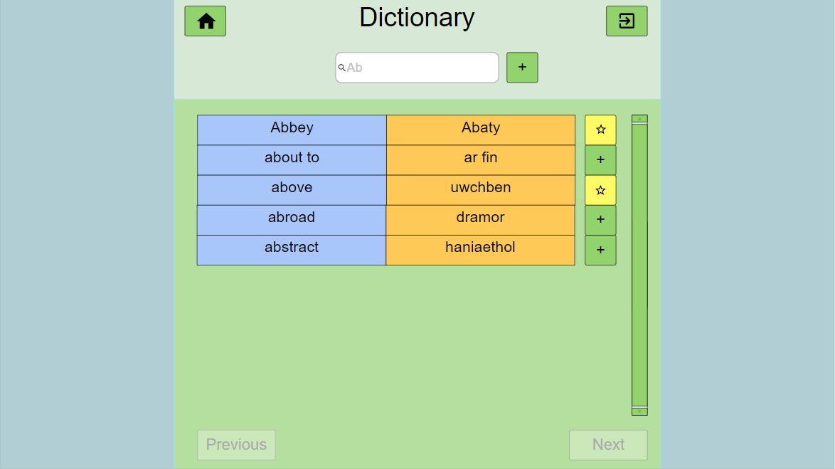
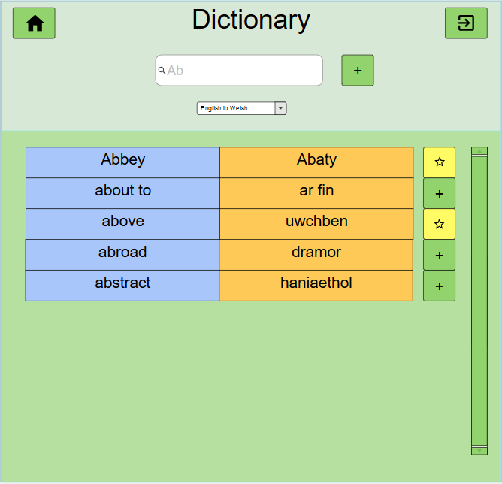
Dictionary
Example: searching a word that begins with “ab”
My words
Welsh-English Dictionary

Slide 5
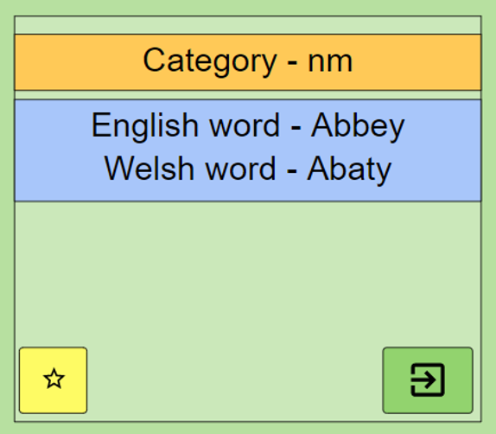
Dictionary
Click on a word to show properties
My words
Welsh-English Dictionary

Slide 6
Dictionary
Add new word pop-up box
Welsh-English Dictionary
Add new word
English
Word type field
Welsh
Word type field
Word type
cancel
Add word
Drop down menu that allows to choose
the type of the word
Simply write the English word and the welsh
Word and click on the “Add word” button:
The word will be now in the dictionary.

Slide 7
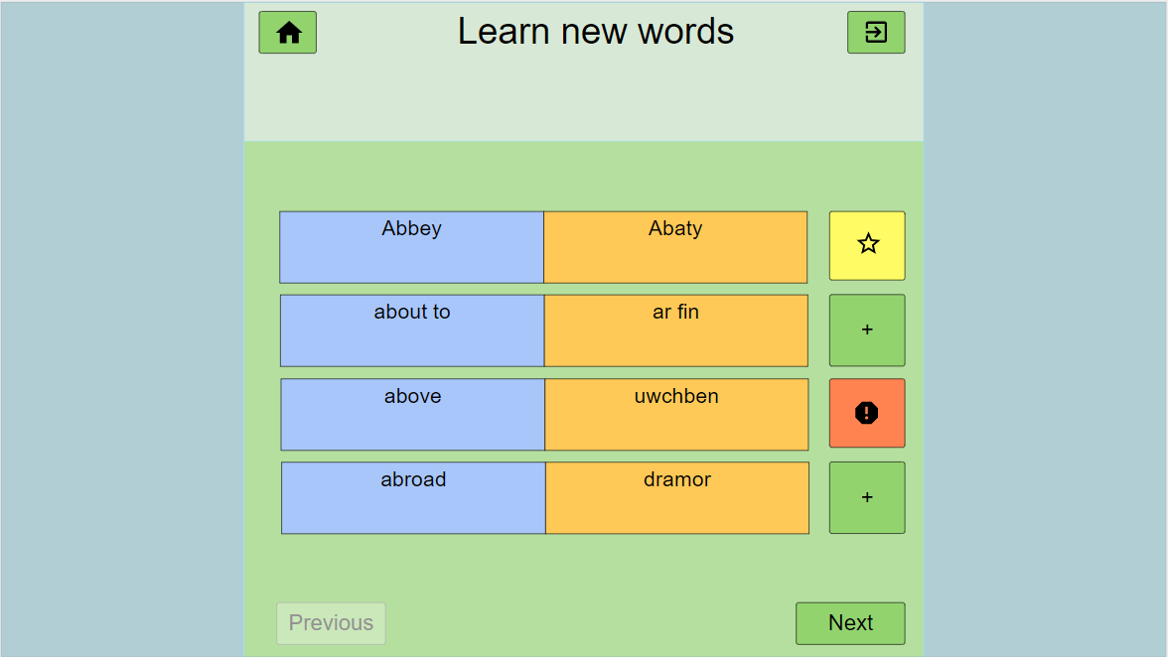
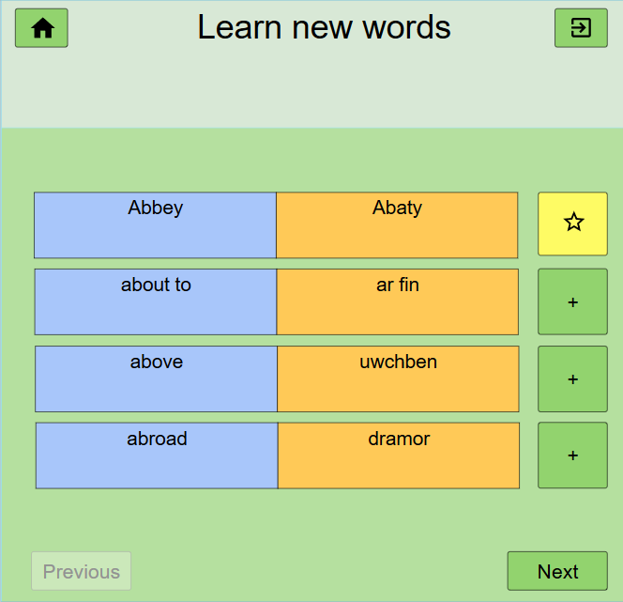
Practice list
This function will show new words from the dictionary and allow the user to
memorize them in small groups of words. The words the user wants to learn are
saved in the “my words”, so he can practice later on.
Practice list
My words

Slide 8
Practice list
Home button
Exit button
Random (or ordered) list of words
4 each screen in this layout
Practice list
Buttons to save a word in list
Next and previous group of words

Slide 9
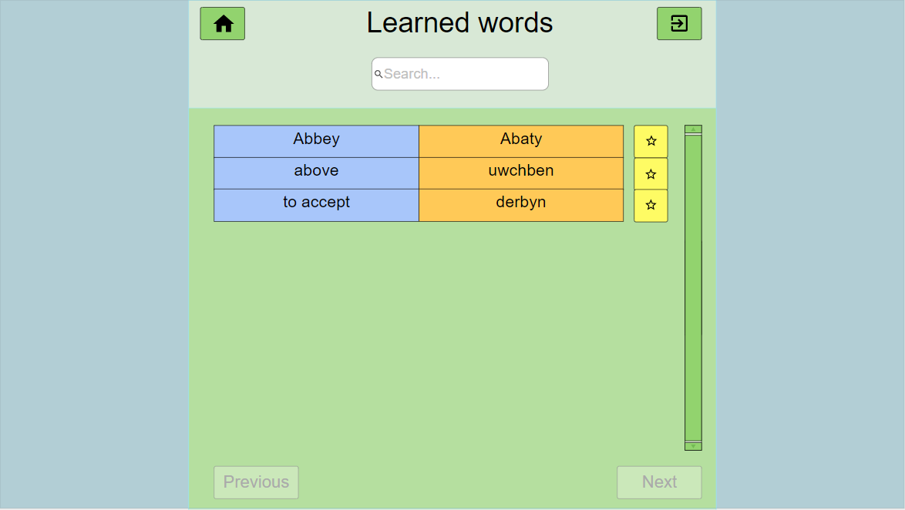
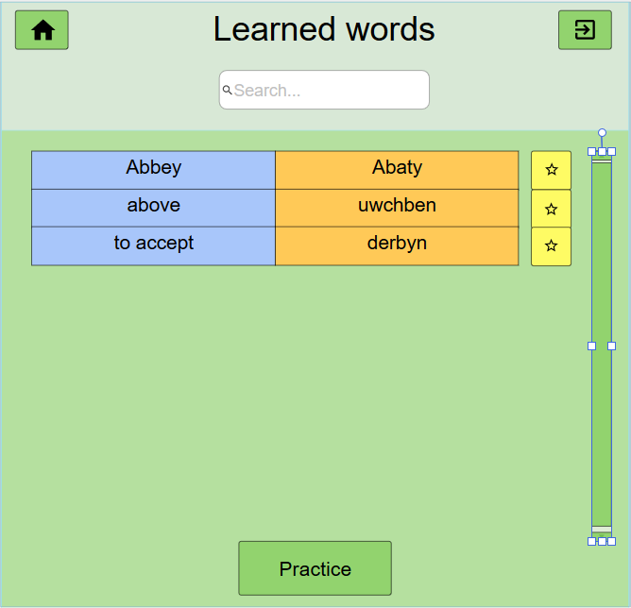
My words
Search bar (when the list is big enough)
My words
List of words
Scrolling bar
(when list is big)
Go to Practice Words page

Slide 10
Practice Words
Practice Words
Select practice mode
In “my words” section, the practice for those words can be accessed, so the user
Can practice on the words he wants to learn.
Flashcards
Test

Slide 11
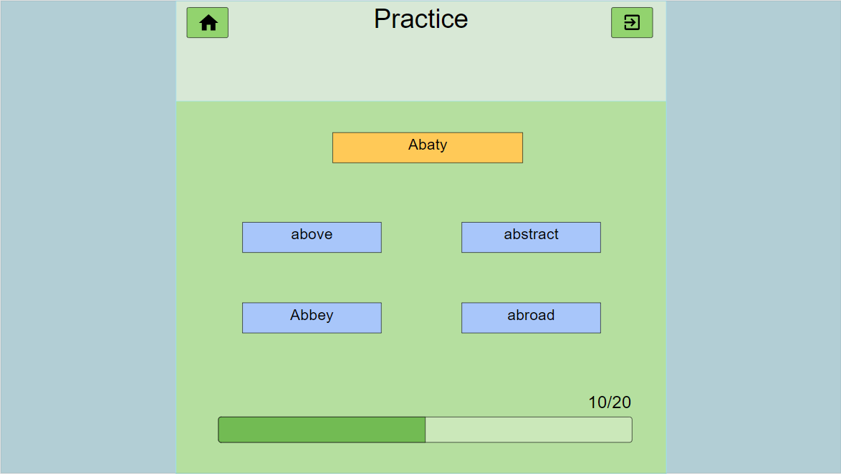
Practice words
Practice mode 1: flashcards
Card in welsh and then in english
Abbey Category - nm
Abaty
Click on this card to show the English translation
Progress bar

Slide 12
Practice words
Practice mode 1: flashcards
Card in welsh once opened
Abaty
Category - nm
Click on this card to show the English translation
Progress bar

Slide 13
Practice words
Practice mode 2: guess the correct translations of the words
Above
Year
Tomorrow
Abstract
Abbey
Abroad

Slide 14
Practice words
Practice mode 2: guess the correct translations of the words
Word to guess
Possible solutions
Above
Year
Tomorrow
Abstract
Abbey
Abroad
Progress bar

Slide 15
Practice words 2:guess the word
Correct answer case
Wrong answer case
Wrong answer (+0) points
above
Tomorrow
Year
Correct answer (+1) points
Abbey
11/20
Progress bar

Slide 16
Practice words
Practice mode 3: type the correct translation of a word
Word to translate
Above
Type the correct word
uwc____
Skip to next question
(0 points)
skip
Progress bar

Slide 17
Practice words
Practice mode 4: match the words with the correct translation
Step 1: choose the word to match
Step 2: choose the translation
Repeat with all words, after
give points based on score
Different colors can be used
for each pair of words
Above
Above
Abaty
Abbey
Dramor
Abstract
Uwchben
Uwchben
Abroad
Haniaethol
Progress bar

Slide 18

Test mode
At the end of the test, a pop up screen will display the results
Score: 95/100
new test

Slide 19
DOCUMENT HISTORY
Version | CCF No. | Date | Changes made to this document | Changed by
1.0 | N/A | 5/02/2020 | First release | fec11
2.0 | #1 | 20/02/2020 | changed order menu button; just 1 list practice; removed ‘prev’ and ‘next’ buttons; practice in my words list option for practice; remove next and previous + button; shows popup to complete word editor | fec11
2.1 | #2 | 27/02/2020 | Revision after problems found by Christ Price report | fec11
3.0 | #2 | 10/03/2020 | Changed menu words so they fit better together; More explanation linking to use cases; added new flashcard case; added new practice “my words” selection screen; Fixed graphic issues in presentation | fec11
4.0 | #2 | 27/04/2020 | Added 2 words to guess according to the requirements Added “type word” practice mode Added “match words” practice mode Added “test mode” option Added screen explaining “test mode” | fec11

Slide 20
DOCUMENT HISTORY
Version | CCF No. | Date | Changes made to this document | Changed by
4.1 | #3 | 27/04/2020 | -change config ref to SE_G17_UI_PRES -Remove the main menu and options and have the program open on the dictionary. Change "words to learn" to practice list. Header read "Welsh-English Dictionary" -Remove the ability to remove words from dictionary/practice list -Add new word needs to have a word type field or drop down selction -No need to save words from practice list to another list -No need for a random word ordering for practice list -No need for "Learned words" just the practice list -Practice should only have two options, one for flashcards and one for running the tests - Fixed other parts | fec11
4.2 | #3 | 27/04/2020 | -added a new slide that shows what happens when the user presses the flashcard -Removed slide -Removed unnecessary button | fec11

Slide 21
DOCUMENT HISTORY
Version | CCF No. | Date | Changes made to this document | Changed by
4.3 | #3 | 30/04/2020 | Removed language choice in dictionary search as it is not needed Removed from all the slides and fixed every image containing it Removed explanatory note | fec11

